Slide 1
Machine learning Mini-project: NCA - Neighborhood Components Analysis
Cui Xiao

Slide 2
Catalog
Introduction of NCA
Performance of NCA
Compare with other similar algorithms
My Code

Slide 3
NCA - Neighborhood Components Analysis
Neighbourhood components analysis is a supervised learning method for classifying high dimension data into distinct dimension data according to a distance metric learning from data.
Some keyword：
Dimension reduction und Feature selection
Mapping to a new space
Boosting the effect of KNN

Slide 4
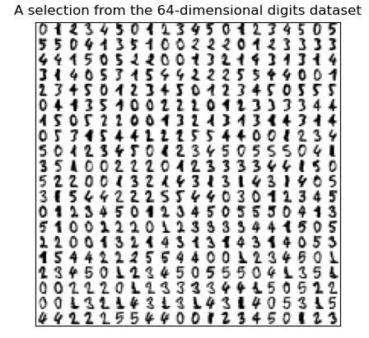
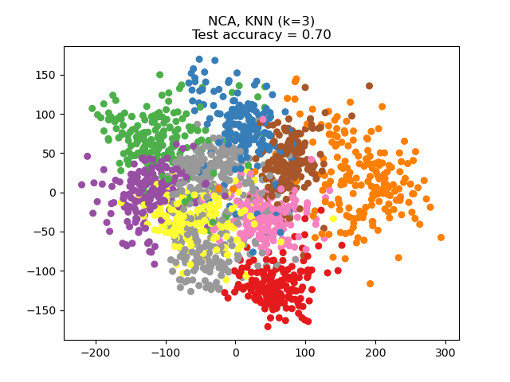
What is the NCA?
Dimension reduction
Dataset: MNIST
Features: 28*28 = 784
Features: 2
Reduce the dimension to make the visualization much easy.
Less feature means saving calculation resource.
[2]
Notes:
介绍MNIST
告诉大家，图上在干啥
好处

Slide 5
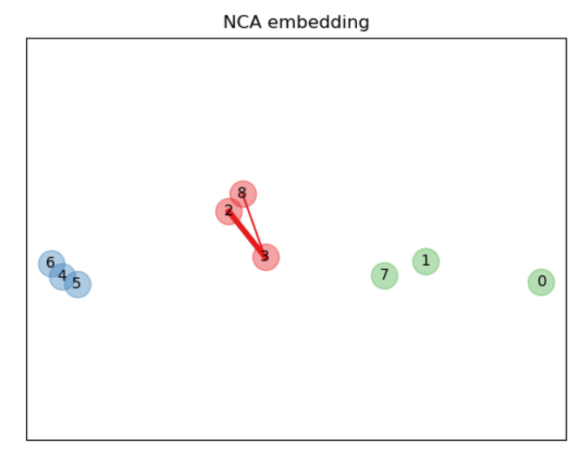
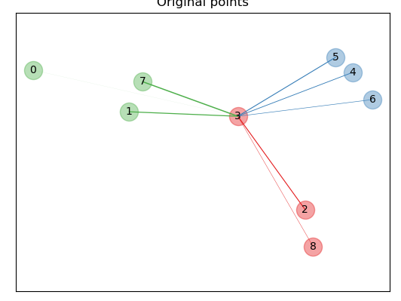
What is the NCA?
Data category interval becomes larger
[1]
Notes:
解释这是什么东西
发生了什么
有什么好处

Slide 6
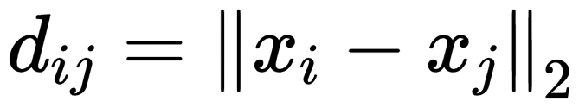

NCA and KNN
Process of KNN
Calculate the Euclidean distance between sample i and all the remaining samples
Select the k samples with the smallest distance
The predictions are obtained by voting using the labels of these k samples
How to improve KNN ?
How to make KNN faster ?
How to make KNN much more accurate?
Notes:
有一个Knn
Knn的问题
Sample 或者 feature多 就会慢
准确率如何提高

Slide 7
NCA and KNN
From lecture:
Accuracy：
find a more suitable k using cross-validation
change the distance function
Speed：
？？？？
NCA:
to get a new distance function, that is designed especially for each datasets
to reduce the dimension of datasets to speed up
Notes:
提高精度方法
提高速度的办法
NCA都能解决
Reducing the feature

Slide 8
How does the NCA work?
In NCA, our aim is to obtain the distance matrix by machine learning
training datasets
NCA
Distance matrix
distance matrix
training datasets
new training datasets
distance matrix
test datasets
new test datasets
1. NCA 2.KNN
Notes:
通过训练得到距离矩阵
借助距离矩阵，获得新的训练datasets和testsets
Sum up

Slide 9




How does the NCA work?
the probability $P(x_{j})$of points j being selected according to their distance.
where k is an equation on distance.
Set a new distance function
with $w_{r}$ is the feature weight.
[1-3]

Slide 10
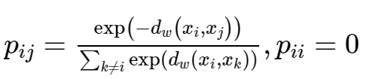

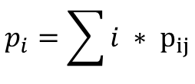
How does the NCA work?
Thus for point i, the probability of selecting point j is
Set ，the probability of selecting the right point is
$i=1 if y_{i}=y_{j} esle i=$0
$$p_{i}=\sum{i ∗ p_{ij}}$$
[1-3]

Slide 11

How does the NCA work?
to make the accuracy rate improve, sum all possibilities together
Optimization of f by gradient descent
[1-3]
Notes:
尽可能多的点得到更容易的选择到正确的点，因此全局可能性就需要提高

Slide 12
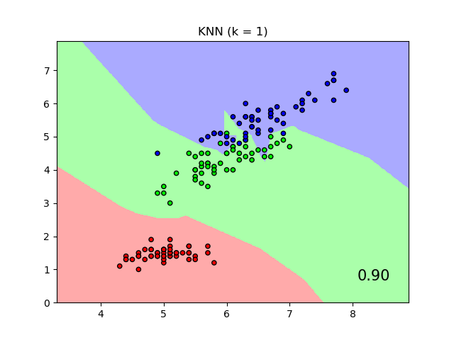
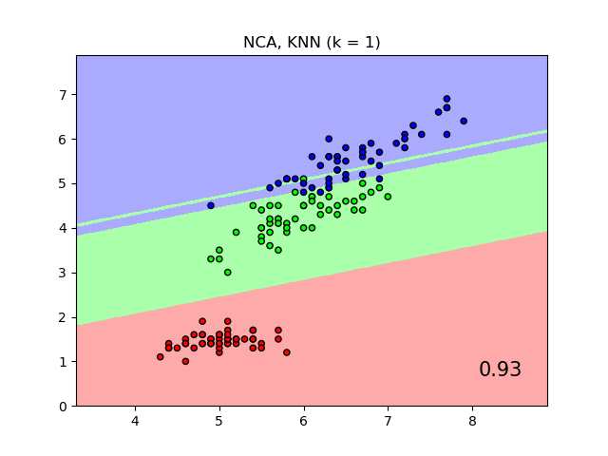
NCA on iris datasets
Improvment of KNN performence
a new distance function for each datasets

Slide 13
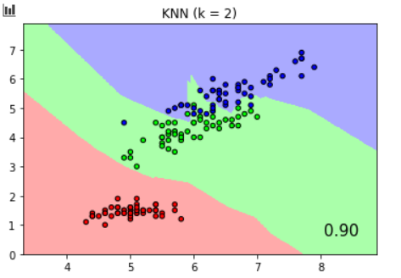
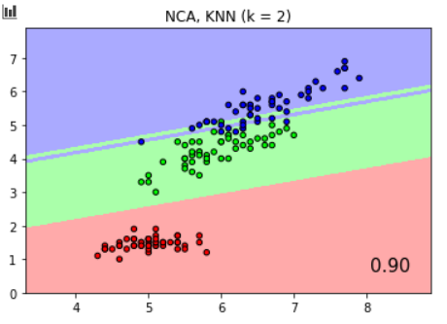
Drawback of NCA
Notes:
Knn NCA 流程

Slide 14
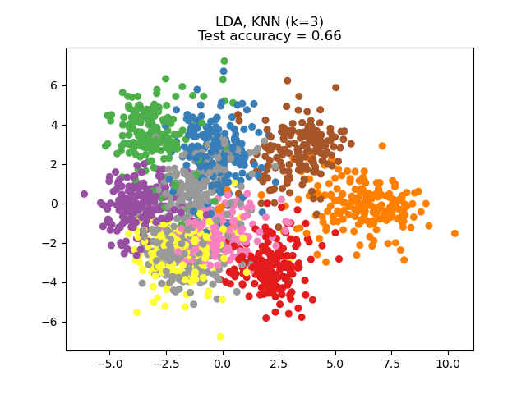
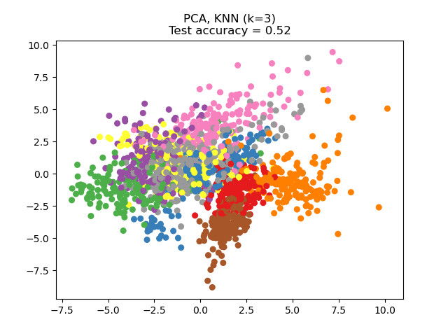
Other dimension reduction algorithms
Dataset: MNIST
LDA
NCA Neighborhood Components Analysis
PCA Principal Component Analysis
LDA Linear Discriminant Analysis
PCA
NCA
[5]
Notes:
说名字
说图 效果不一样，因为降维目的不一样

Slide 15
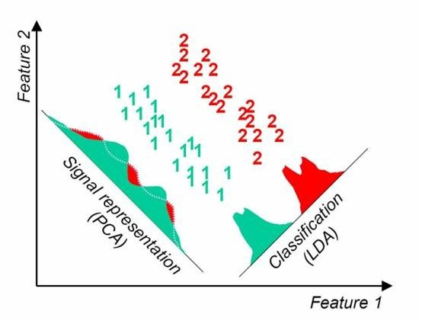
Other dimension reduction algorithms
LDA: the most variance between classes in projection direction
PCA:the largest variance in projection direction
NCA: the best performance of the stochastic nearest neighbor algorithm in new space
[6]

Slide 16
Other dimension reduction algorithms
Table 1 : compare of the different algorithms
characteristics | PCA | LDA | NCA
Un-/supervised learning | Unsupervised learning | Supervised learning | Supervised learning
Function | Dimensionality reduction | Dimensionality reduction/classification | Dimensionality reduction/classification/regression
Downscaling Limits | no limit | max to k-1 | no limit
Data Distribution | Gaussian distribution | Gaussian distribution | no limit
[3,7]

Slide 17
My code
# gradients for-loop gradients = np.zeros((self.high_dims, self.high_dims)) # for i for i in range(self.n_samples): k_sum = np.zeros((self.high_dims, self.high_dims)) k_same_sum = np.zeros((self.high_dims, self.high_dims)) # for k for k in range(self.n_samples): out_prod = np.outer(X[i] - X[k], X[i] - X[k]) k_sum += pij_mat[i][k] * out_prod if Y[k] == Y[i]: k_same_sum += pij_mat[i][k] * out_prod gradients += pi_row[i] * k_sum - k_same_sum gradients = 2 * np.dot(gradients, self.A)
# gradient #1 matrix part_gradients = np.zeros((self.high_dims, self.high_dims)) for i in range(self.n_samples): xik = X[i] - X prod_xik = xik[:, :, None] * xik[:, None, :] pij_prod_xik = pij_mat[i][:, None, None] * prod_xik first_part = pi_row[i] * np.sum(pij_prod_xik, axis=0) second_part = np.sum(pij_prod_xik[Y == Y[i], :, :], axis=0) part_gradients += first_part - second_part gradients = 2 * np.dot(part_gradients, self.A)c
[9]
 | Loop-style | Vector-style
Runtime | 98.824s | 9.84363s
Accuracy | 0.9619 | 0.9619
[8]

Slide 18


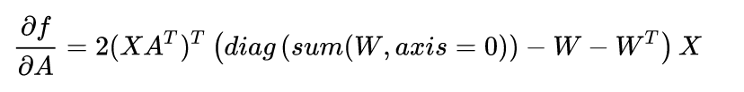
My code
set
Benefit :
Reducing the number of matrix multiplications
Reducing the size of the matrix
[7]

Slide 19
My code
# gradients #2 part_gradients = np.zeros((self.high_dims, self.high_dims)) for i in range(self.n_samples): xik = X[i] - X prod_xik = xik[:, :, None] * xik[:, None, :] pij_prod_xik = pij_mat[i][:, None, None] * prod_xik first_part = pi_row[i] * np.sum(pij_prod_xik, axis=0) second_part = np.sum(pij_prod_xik[Y == Y[i], :, :], axis=0) part_gradients += first_part - second_part gradients = 2 * (part_gradients @ self.A)
 | Loop-style | Vector-style | W-style | Sk-learn
Runtime | 98.824s | 9.84363s | 6.8411 | 0.075s
Accuracy | 0.9619 | 0.9619 | 0.9619 | 0.9809
[7]

Slide 20
References
[1] J. Goldberger, G. Hinton, S. Roweis, R. Salakhutdinov. (2005) Neighbourhood Components Analysis. Advances in Neural Information Processing Systems. 17, 513-520, 2005.
[2] Matlab tutorial - Neighborhood Component Analysis (NCA) Feature Selection
[3] Data dimension reduction| LDA PCA NCA
[4] https://scikit-learn.org/stable/auto_examples/neighbors/plot_nca_classification.html#sphx-glr-auto-examples-neighbors-plot-nca-classification-py
[5] https://scikit-learn.org/stable/auto_examples/neighbors/plot_nca_illustration.html#sphx-glr-auto-examples-neighbors-plot-nca-illustration-py
[6] https://scikit-learn.org/stable/auto_examples/neighbors/plot_nca_dim_reduction.html#sphx-glr-auto-examples-neighbors-plot-nca-dim-reduction-py
[7] Wold, Svante, Kim Esbensen, and Paul Geladi. "Principal component analysis." Chemometrics and intelligent laboratory systems 2.1-3 (1987): 37-52.
[8] Neighbourhood Component Analysis
[9] RolT / NCA-python

